Slide 1
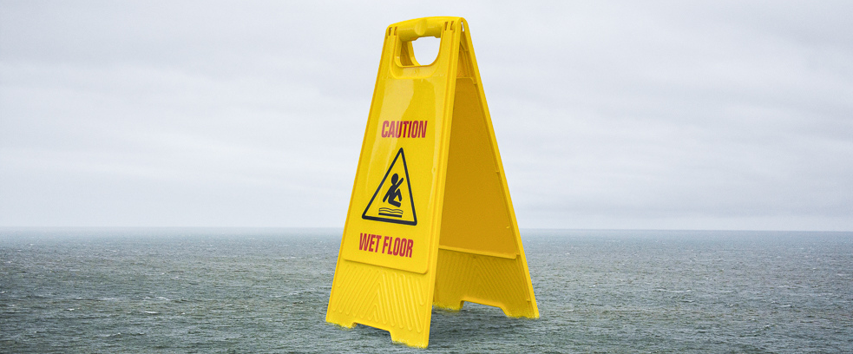
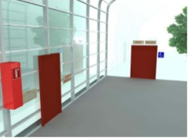
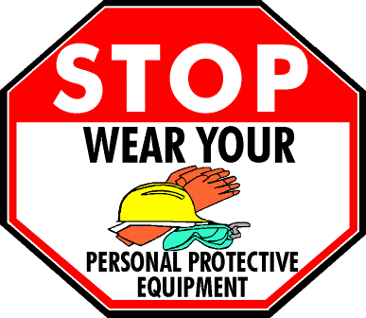
BE SAFE
STAY SAFE
WET FLOOR
SAFETY
DECEMBER 2018
SAFETY REVIEW
Mopping is not just about cleaning the floor, it’s also about keeping people who walk on the floor safe from dirt, soil and slip hazards. Here are some things to keep in mind…
Do not place too much cleaner in your mop bucket. Follow the product guidelines. More is NOT better.
Careful not to hit the ceiling with your mop handle when placing in or removing from the mop bucket.
DO NOT carry items across a wet floor.
Avoid placing excessive amounts of water down on the floor. Do not ‘slop’ mop.
Be sure to change your water frequently, clean your mop head out when done (replace if heavily soiled) and dry upright avoiding its resting on drywall walls or near any type of electrical system, panel or plug.
PLACEMENT is very important. Put a caution sign at every entry point into the area where you will be mopping.
Use Your PPE
Each job site may have different hazard concerns. Know your mopping PPE and use all such equipment properly every time.
POST caution signs
Wear goggles when filling your mop bucket with chemical.
Wear ALL required PPE.
If PPE is not available, STOP, notify your supervisor.
CAUTION signs must be placed before you start adding any liquid to the floor and remain until the floor is dry. AFTER the floor is dry they must be removed. NEVER leave a wet floor sign on a dry floor.

