Slide 1

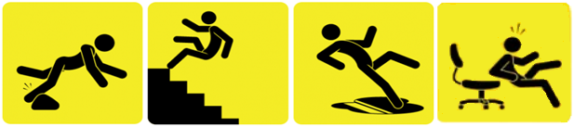


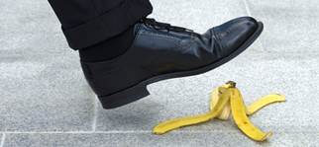
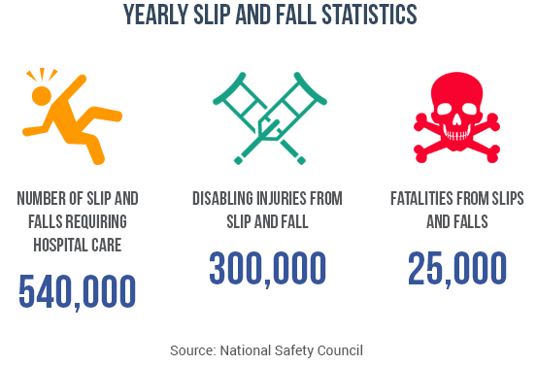
BE SAFE
STAY SAFE
JANUARY
2021
SAFETY
REVIEW
SLIPS & FALL PREVENTION
~ CAUSES ~
Slips
Wet or Slippery floors
Inappropriate footwear
Inclement weather
Loose flooring
Trips
Poor lighting
Moving from lit to darker areas
Walking surface issues
Uneven mats / carpet
Falls
Not following procedures
Carrying objects while using stairs
~ PREVENTION~
Housekeeping
Good housekeeping practices
Clean spills right away
USE WET FLOOR SIGNS (remove when floor is dry)
Remove floor debris and obstructions
Keep floors swept
Secure and cover cords and cables in walkways
Stairways
Keep stairs free from material and debris
Walk slowly and USE HANDRAILS (3 points of contact)
Take one step at a time
Keep outside steps free of ice, snow, and debris
Ladders
Only use if certified to do so
Never use a chair, box, table or other such object
Never use metal ladders near anything electrical
Maintain 3-points of contact at all times on ladders
Personal Protective Equipment
Use proper footwear
Use proper caution signs
Use your PPE
Report dangerous conditions
Wear footwear with good traction and insulation
Take short steps – walk at a slower pace than normal
Do not carry heavy loads to allow your arms to help balance you
Hazards are not always easy to spot. Pay attention to your surroundings and notify your supervisor of any issues that may lead to a slip, fall or other injury.
NUMBERS OF SLIP AND FALLS REQUIRING HOSPITAL CARE
DISABLING INJURIES FROM SLIP AND FALL
FATALITIES FROM SLIPS AND FALLS
540,000
300,000
25,000

Slide 2
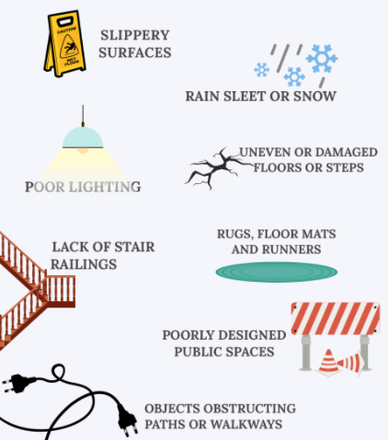
BE SAFE
STAY SAFE
SLIPS & FALL PREVENTION
JANUARY
2021
SAFETY
REVIEW
BE ON THE LOOK OUT…
Most falls result from a combination of issues. Some may involve the floor or ground beneath you, but your age, health and other factors may play a role. Lack of proper safety rails or negligence in keeping surfaces clean, dry or uncluttered (our job) can also contribute to injuries SO BE ON THE LOOK OUT FOR THESE CONDITIONS.
Vision problems, lower body weakness, and problems with walking or your balance can make you more susceptible to falling. Medicines, including over-the-counter drugs, can also affect your balance and make you more prone to tripping or falling on a hazardous surface.
REPORT ALL SAFETY CONDITIONS TO MANAGEMENT.
DO YOUR PART TO NOT CREATE DANGEROUS CONDITIONS

