Slide 1
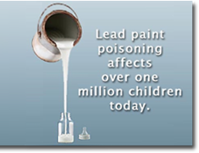
What is lead-based paint?
Lead paint or lead based paint (LBP) is paint containing lead, a heavy metal, that is used as pigment, with lead(II) chromate (PbCro4, ‘chrome yellow’) and lead (II) carbonate (PbCO3, ‘white lead’) being the most common.
Lead is also added to paint to speed drying, increase durability, retain a fresh appearance, and resist moisture that causes corrosion. In some countries lead continues to be added to paint intended for domestic use ^{[1]} whereas in others regulation exists that prohibits this, though lead paint may still be found in older properties painted prior to the introduction of such regulation
Paint with significant lead content is still used in industry and by the military. For example, leaded paint is sometimes used to paint roadways and parking lot lines.

Slide 2
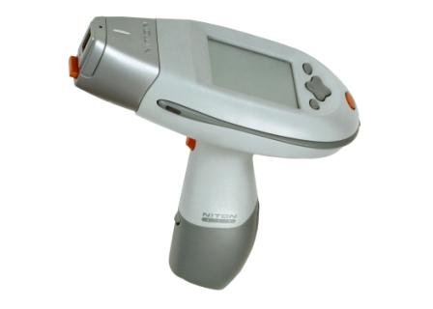
What is lead-based paint?
What is lead-based paint?
The presence of lead in paint is often determined by a laboratory analysis of a paint "chip" sample. A trained inspector can also use a special instrument (XRF) to immediately identify lead in paint.
XRF Sampling Device

Slide 3
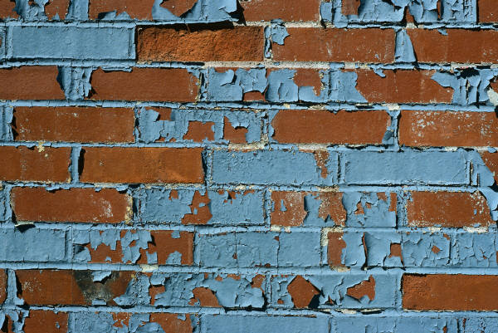
Where is lead-based paint found?
There are over 64 million homes in the US that contain lead-based paint. The vast majority of homes built prior to 1950 contain lead-based paint. HUD and EPA assume that if a house was built after 1978 it does not contain lead based paint, because lead was banned in consumer paint products in 1978.
Typically lead-based paint can be found on any painted surface inside or outside the home:
Interior
Walls
Floors
Ceilings
Stairs,Doors,Trim
Windows (wells, sills, troughs, trim)
Exterior
Siding
Porches (floors, columns, railings and steps
Trim
Soil

Slide 4
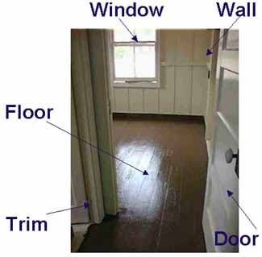
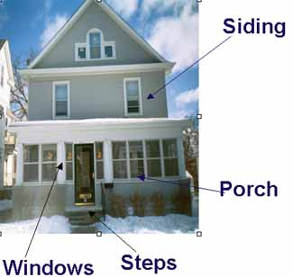
Where is lead-based paint found?

Slide 5
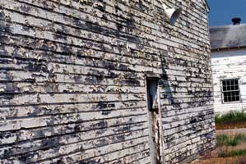
When is lead-based paint hazardous?
The presence of lead in paint does not automatically signify a hazard. However, there are instances when lead paint is hazardous. For instance flaking, blistering, chalking, or peeling paint can fall off in the form of paint chips and contaminate surfaces inside the house. Lead dust can be caused by impact and friction surfaces as well as renovation/remodeling activities. Dust is
the primary health threat.
Exterior paint that is flaking or peeling
can get into the soil and pose a health
threat to children’s play areas.

Slide 6
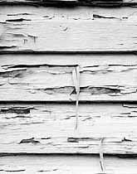
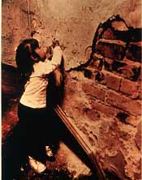
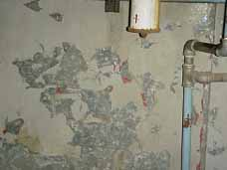
When is lead-based paint hazardous?
Maintaining painted surfaces, interior and exterior, in an intact state (no peeling, chipping, or chalking) especially friction and impact surfaces is extremely important to keep lead hazards to a minimum. Activities that disturb lead-based paint can cause lead dust hazards.
Peeling Interior Point
Peeling Exterior Paint
Peeling Interior Point

Slide 7
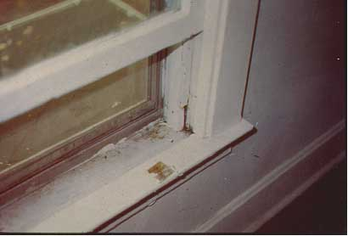
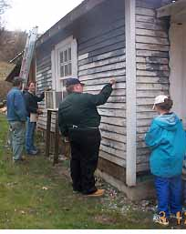
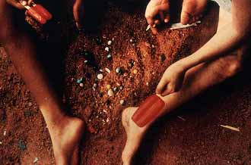
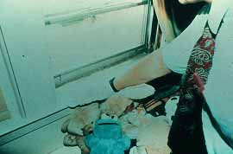
When is lead-based paint hazardous?
Contaminated dust and soil can be tracked into homes
Scraping exterior paint can contaminate soil
Dust from friction can settle on accessible surfaces and toys too

Slide 8
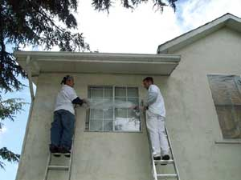
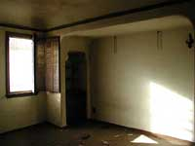
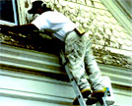
When is lead-based paint hazardous?
Remodeling and renovation activities where paint is disturbed (sanded, scraped, etc.) even in small amounts can cause small lead dust particles to settle over house hold surfaces, even in areas where there are no renovation or remodeling activities. Dust can be generated by contractors and “home improvement” efforts by homeowners.

Slide 9
What does OSHA have to say about LBP?
OSHA (1970) - Employer provides a “safe and healthy” workplace. Employee abides by employer rules concerning same.
OSHA Lead Standards in Industry:
OSHA 29 CFR 1910.1025 – General
OSHA 29 CFR 1926.62 – Construction
OSHA 29 CFR 1915.1025 – Maritime

Slide 10
Routes of entry into the body:
Lead can be inhaled in the form of dust
Lead can be ingested in the form of paint chips, soil contaminated with lead, toys or other objects covered with lead dust, tainted drinking water

Slide 11
Health effects – Adults:
Adults can suffer from:
Difficulties during pregnancy
Other reproductive problems (men & women)
High blood pressure
Digestive problems
Nerve disorders
Memory and concentration problems
Muscle and joint pain

Slide 12
Health effects – Children:
Children with high lead levels can experience:
Damage to brain and nervous system
Behavior and learning problems (hyperactivity)
Slowed growth
Hearing problems
Headaches

Slide 13
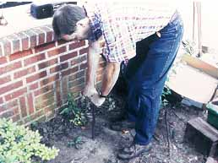
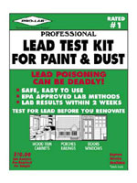
How / Where can we test paint, dust, soil for lead?
Home owners should consider hiring an EPA accredited lead inspector/ risk assessor professional to test and check the home inside and out and offer guidance on any identified lead based paint hazards.
Some local accredited laboratories may offer services for lead testing.
Some commercial test kits for lead dust are currently available; however studies suggest that they are not always accurate. Consumers should not rely on these tests before doing renovations or to assure safety.
In our facilities we also rely on our customer’s knowledge of their physical ‘plant’ and notifications of potential lead exposure.

Slide 14
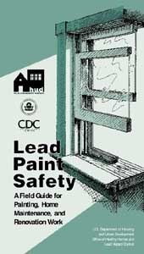
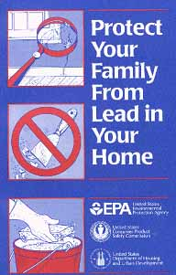
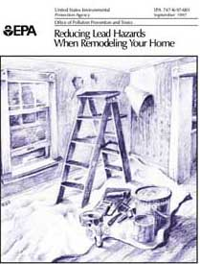
How can I safely repaint over lead-based paint?
There are several FREE booklets published by the EPA and HUD that tell you how to work safely with lead-based paint which you can use for your PERSONAL information.
All Omni employees are not authorized to ‘paint over’ or ‘seal’ lead paint. This type of work is done by Omni authorized, trained professionals.

Slide 15
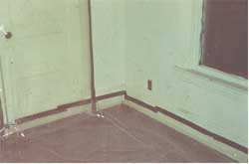
How can I safely repaint over lead-based paint?
You want to protect yourself, other occupants and all your belongings from lead dust. Surface preparation methods should include wet scrubbing (DO NOT DRY SAND, SCRAPE OR HEAT) the surface to prepare it to accept new paint.
Keep work area isolated. Keep children out of work area when working with lead-based paint.
When working outside, close all windows and doors before surface preparation.
When working inside, move everything out of the work area that can be moved. Cover everything else with plastic, especially doors and/or windows leading to other areas of the house. Containing the work area
makes easier cleanup and minimizes lead dust in
other areas. Work in small areas (one room at a time).

Slide 16
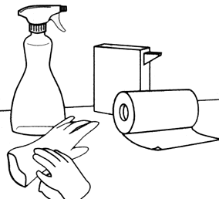
How can I safely repaint over lead-based paint?
Mist the painted surfaces with water during any activities that disturb the paint, minimizing dust.
Promptly clean up any dust and debris that is generated with high efficiency particulate air (HEPA) vacuums and wet mop or clean with soap and water. Wear disposable gloves. Rinse the area with clean water. Change the water often to avoid putting lead dust back onto the surface. (Dirty water should be flushed down a toilet.)
Wash hands and face as soon as you leave the work area. (Wash clothing separately from other laundry.)

Slide 17
Where can I go for more information?
National Lead Information Center has a toll free number where you can get information at 1-800-424-LEAD. Many local health departments have information on lead.
There are numerous resources on-line:
United States Department of Housing and Urban Development: www.hud.gov Clear Corps: www.clearcorps.org Environmental Protection Agency: www.epa.gov National Paint and Coatings Association: www.paint.org Consumer Product Safety Commission: www.cpsc.gov Lead Listing: www.leadlisting.org Center for Disease Control: www.cdc.gov Paint and Coatings Industry Information Center: www.paintinfo.org
Or use your favorite search engine and search on “Lead-Based Paint”

Slide 18
What to do if you suspect overexposure?
If you suspect your child has been lead poisoned or has an elevated blood lead level, you should do the following:
Take him/her to your local health care provider or health department and ask for a lead screening
Contact your local health department
What to do if you suspect LBP at the job site?
If you have questions about LBP on the job ASK your supervisor. If they don’t know they will find out for you.

Slide 19
Who is affected the most?
Any child and any person from any background can be affected

