Slide 1

Gdi-omni school of sanitation
Because sanitizing is more than cleaning!

Slide 2

FOOD SAFETY ESSENTIALS
Understanding HACCP
7
Powered by

Slide 3
objectives
HACCP Defined
HACCP Principles
HACCP Deviation Report & Manual
Understanding
HACCP
Notes:
In this Food Safety training module we will cover the an important program in food safety known as HACCP. We will talk about what it means, the basic principles of it as well as reports and manuals the plants we work in must develop.
As food safety professionals working in sanitation you do not typically deal with HACCP directly (it’s development, reporting or implementation) but many of your day-to-day actions are following HACCP plans and procedures so we should all be familiar with what this important program is all about.

Slide 4
Definition
H A C C P
Understanding
HACCP
Notes:
So let’s first Define HACCP

Slide 5
Definition
H
A
C
C
P
EALTH
NALYSIS
RITICAL
ONTROL
OINT
H A C C P
Understanding
HACCP
Notes:
HACCP is a way to evaluate ingredients and processes in order to prevent, or reduce to an acceptable level, product contamination or other conditions that can cause illness, injury or death.
It is an important program to help provide safe, clean, and healthy food.

Slide 6
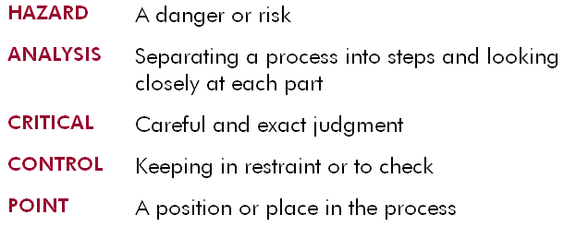
Understanding haccp
Understanding
HACCP
Notes:
It’s easier to understand HACCP’s function if you know what each word means in more simpler terms. Let’s review each component of HACCP’s meaning.
[READ THROUGH SLIDE]

Slide 7
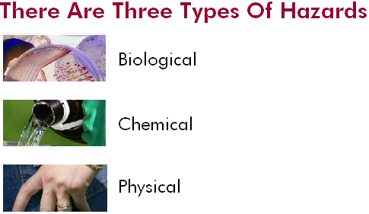
Hazards
Understanding
HACCP
Notes:
Let’s take a look at the 3 types of Hazards – our first stop in understanding HACCP

Slide 8
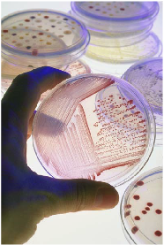
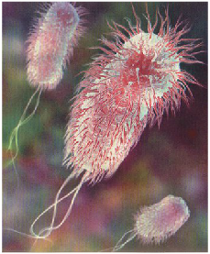
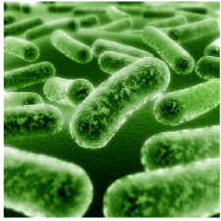
Hazards - biological
Understanding
HACCP
Notes:
Biological hazards come from living microorganisms or, in the case of bacteria, their by-products.
Some examples are harmful bacteria such as E. coli found in ground beef or Salmonella found in raw eggs.

Slide 9
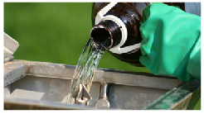
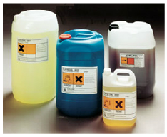
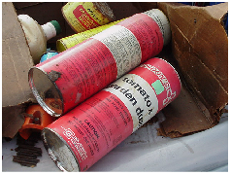
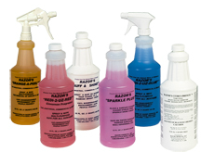
Hazards - Chemical
Understanding
HACCP
Notes:
Chemical hazards come from chemicals in the plant that can get into the product.
For example, maintenance and cleaning chemicals, allergens, pesticides and so forth can all cause contamination.
This is why you never bring a chemical into the plant that has not first been approved by the plant’s HACCP & Safety teams.

Slide 10

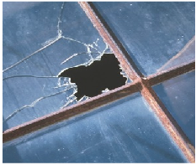
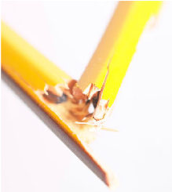
Hazards - physical
Understanding
HACCP
Notes:
Physical hazards are any foreign object found in a product that can potentially harm the consumer.
Examples are metal, glass, wood, bone, plastic or jewelry.
See if you can ID the hazard, or hazards, in each of the following images:
Image 1: broken glass. ALWAYS report broken glass or brittle plastic. DON’T clean up unless you are trained in the special ways to do so. Glass dust, not just large pieces of glass, are a physical hazard and special care must be taken to remove all of it.
Image 2: broken pencil. Pencils and even many pens can fall into the product. This is way many plants issue their own special metal detectable pens. This is also why you never put pens in a shirt pocket (WHY? A: they could fall into the product stream)
Image 3: We have 2 physical hazards: ring and bracelets. Be sure to know your plant’s policy on rings – some allow a single wedding band with NO stones but beyond that possible exception all other jewelry should be removed.

Slide 11

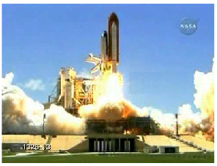
Haccp history
Understanding
HACCP
Notes:
HACCP began after NASA and other agencies involved with the space program approached the Pillsbury Company and asked it to create foods that could be eaten at zero gravity.
NASA wanted to be 100 percent certain the products would not cause injury or illness from bacterial pathogens, toxins or chemical or physical hazards.
The approach they used evolved into the food safety program we now know as HACCP.

Slide 12

Beginning a Haccp program
Establishing a good, basic set of programs developed around GMPs & using them consistently
Gaining management support for the HACCP program
Describing and identifying the food product, its distribution, its intended use, and potential customers
Completing and verifying a flow diagram
Understanding
HACCP
Notes:
Now that we have learned a little about what HACCP means and where the whole concept originated from, let’s look at the beginning steps of who a company would go about putting together a HACCP program or plan.
These preliminary tasks must be completed before beginning a HACCP program:
[see slide builds – 4 bullets, one click each to build]

Slide 13
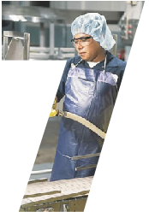
Seven steps to haccp
Conducting a hazard analysis
Identify control points
Establish critical limits
Establish monitoring procedures
Establish corrective action
Verification
Recordkeeping
Understanding
HACCP
Notes:
There are seven HACCP principles that you must complete in sequence to have a complete and effective HACCP program.
[see slide builds – 7 bullets, one click each to build]
Conducting a hazard analysis
Identify control points
Establish critical limits
Establish monitoring procedures
Establish corrective action
Verification
Recordkeeping

Slide 14

Principle 1: conducting a hazard analysis
“This principle is the most important because if a possible hazard is not identified, no control program will be established.”
Understanding
HACCP
Notes:
The first principle involves understanding the biological, chemical, and physical hazards that could occur in food production. This principle is the most important because if a possible hazard is not identified, no control program will be established.
It is necessary to identify all possible hazards before taking further action.

Slide 15


Principle 1: conducting a hazard analysis
Ingredient Analysis
Process Analysis
Understanding
HACCP
Notes:
There are two types of analysis: Ingredient and Process.
Ingredient hazard analysis identifies any hazard that is reasonably likely to be present in each ingredient. For example, eggs can carry Salmonella bacteria.
Process hazard analysis identifies any hazard that is likely to occur at each process step. For example, using common utensils (i.e. scoops, spoons, ladles, and so forth) to handle different products can cause allergen cross-contamination.
Focus only on hazards that might cause harm. The basis of a HACCP program is a complete analysis of all hazards that can affect food safety. When trying to find these hazards, only look for those that could cause illness or injury to consumers. Taste, smell, or appearance of the product are normally quality issues, not HACCP issues.

Slide 16

Principle 2: identify critical control points
Understanding
HACCP
Notes:
The second principle is to identify your critical control points or CCPs. A CCP is a step in the process where you are able to control a factor that will eliminate a hazard or at least reduce it to an acceptable level. A true CCP is the last step where control can be measured and monitored.
For instance, metal detectors monitor product for any possible metal contamination that may occur during processing.
As a CCP, a metal detector is located as close to the end of the process as possible. It may be located just before the products is packaged or just after packaging, depending upon the product and/or the packaging material u. A metal detector will tell if metal contamination is present and reduce the potential for product contamination.

Slide 17
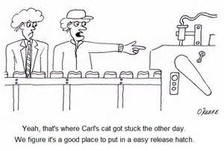
Principle 3: establish critical limits
Understanding
HACCP
Notes:
Critical limits define whether a process is ‘in control’ which means not causing a potential hazard, or ‘out of control’ which means that a hazard may have occurred
For example, a metal detector that is not working properly is a process that is out of control.
Also, not reaching the temperature necessary to kill microorganisms during process is a critical

Slide 18

Principle 4: establish monitoring procedures
What to measure
How to collect the data
How often to collect the data
Who will measure and record the data
Understanding
HACCP
Notes:
After establishing Critical Control Points, it is necessary to monitor those control points.
The HACCP team should determine:
What to measure
How to collect the data
How often to collect the data
Who will measure and record the data
The goal is to keep the process in control and to identify when it is out of control.

Slide 19
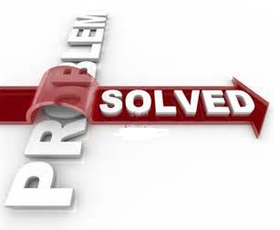
Principle 5: establish corrective action
Place product on hold
Bring CCP back under control
Document the deviation
Re-run or discard held product
Understanding
HACCP
Notes:
A good HACCP program has a clear, easy-to-understand procedure for each CCP. This means that at every CCP, an employee can find instructions that describe how to handle any situation. Corrective action will identify what must be done if a critical limit has been exceeded, i.e., the process is out of control. Corrective action will include the following steps:
Place product on hold
Bring CCP back under control
Document the deviation
Re-run or discard held product
[a good time to talk about an event where this happened at a plant – avoid customer names]

Slide 20

Principle 6: verification
Keep written records
Note monitor’s habits/records
Make equipment checks
Responsible monitor sign off
Understanding
HACCP
Notes:
The 6th principle is verification. This step double checks the process and provides a process for long term review. Verification consists of the following steps:
- keep written records
Note the regular monitor’s work habits and review records
Make independent equipment checks
Have someone other than the responsible monitor sign off to note what took place.
For example, verifying that the metal detector works properly and recording it in a second, separate log is a double-check of the procedure. Annual supplier audits and lab analysis of critical ingredients are examples of long-term verifications.

Slide 21

Principle 7: record keeping
“Without documenting an event when it occurs, it will be difficult to prove it happened.”
Understanding
HACCP
Notes:
The HACCP program depends on accurate record keeping. Without documenting an event when it occurs, it will be difficult to prove it happened.
Here are some good rules to live by when performing good recording keeping practices:
Never pre-record, estimate or rely on memory when recording data.
Make sure to record the data at the exact time that the monitoring occurs to prevent mistakes.
Keep files of every document completed and other pertinent information for the HACCP program. Proper records can help answer customers’ questions and also can be used to justify change when it is needed.
Keep records on site for at least six months. Records can then be moved off site, but they still must be kept long enough to ensure that the product has ben safely used by the customer or consumer.
Each company will have specific record keeping requirements. Always know and follow them.

Slide 22
Deviation report
What factors caused the process to go out of control?
What action was taken to bring the process back in control?
What happened to the product that was being created when the process went out of control?
What long-term corrective action was taken to keep the process in control in the future?
Understanding
HACCP
Notes:
If a process does go out of control, it’s important to answer the following questions:
What factors caused the process to go out of control?
What action was taken to bring the process back in control?
What happened to the product that was being created when the process went out of control?
What long-term corrective action was taken to keep the process in control in the future?
This is completed through the use of a Deviation Report

Slide 23
Haccp manual
Company Information
HACCP Team
Understanding
HACCP
Notes:
Each facility should have a HACCP manual. This manual should contain:
Company Information
This section can include background information about the organization, information about the company’s products, and the company’s mission statement.
HACCP Team
This section of the manual should clearly identify the names and job positions of all HACCP team members. Make sure the team coordinator is identified. Training records should also be included as they related to HACCP.

Slide 24
Haccp manual
Prerequisite Programs
Process Flow Diagram
Hazard Analysis
Understanding
HACCP
Notes:
The manual should also include:
Prerequisite Programs
This section should have a description of each prerequisite program required for an effective HACCP plan.
Process Flow Diagram
Which is a simple picture that outlines the correct sequence of the process steps. It must also include all the basic steps as well as all Critical Control Points.
Hazard Analysis
These forms, ingredients and process hazard analysis, identify what potential hazards exist and how they are controlled.

Slide 25
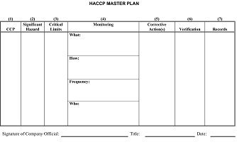
Haccp manual
The Master Plan
Blank Deviation Report
Understanding
HACCP
Notes:
Finally each HACCP manual should have a:
Master Plan
Which summarizes the CCPs and the critical limits that go along with them.
A Blank Deviation Report
That your company will use to describe any corrective actions taken when a limit is exceeded should also be included.

Slide 26

conclusion
Understanding
HACCP
Notes:
The HACCP program is a great way to prevent hazards that could harm the customer (end user / consumer of the product(s)).
By knowing what the potential hazards are and what you should do if they occur, you are significantly helping keep food safe.
You may not be part of a HACCP team or design your own HACCP program BUT you ARE a critical part of the overall effort to keep food safe and understanding HACCP is an important step in the process.

Slide 27
The tools we use
Clean tools are good sanitation...
Understanding the color code system for your plant
Keep your tools stored by color
Clean your tools using the 4 pillars
Follow GMP
Notes:
Tools are a basic part of our job, an important apart and basic understanding of them will keep you, and our food stream safe.
Understand the color coding system. Keep your tools segregated and stored by their color codes. Properly care for your tools and follow the 4 pillars of sanitation when cleaning them and always follow company GMP when transporting, using or bringing in outside tools into the plant environment.

