Slide 1
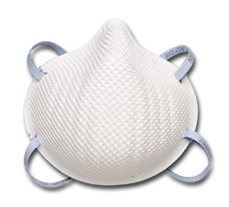
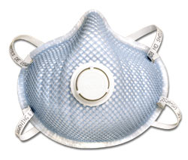
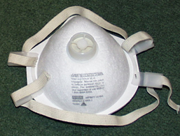
Respirator Training–Module 1
Filtering Facepiece Respirators (Dust Masks)
Notes:
“This training was prepared by the Dept. of Labor & Industries - with modifications and additions we added to apply to our specific workplace situation. This training is on filtering facepieces, commonly called dust masks, and may also be called “disposable masks” or “single use masks.”

Slide 2
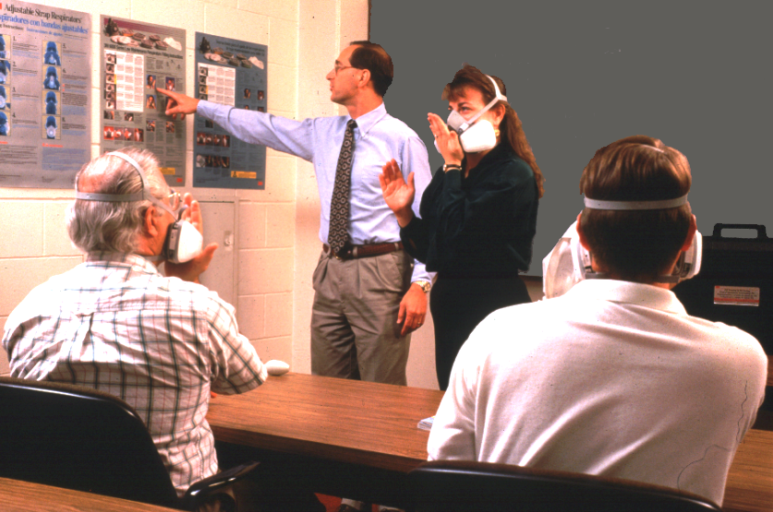
Dust Mask Training
Why Is This Training Required?
Training is required for anyone who wears a Dust Mask.
We also are providing this training so you will know how to protect your health.
If you don’t know how to use a dust mask properly, you can get a false sense of protection.
Notes:
“It is not enough just to slap on a respirator and go. You need to know the reasons for the use of respirators, how they protect you, their limitations, how to use them, keep them in good condition and store them.”

Slide 3
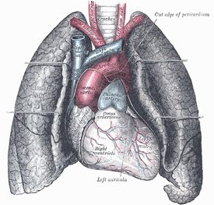
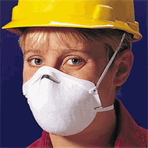
How Filtering Facepieces Work
How Do Dust Masks Protect You?
When used properly, dust masks prevent the inhalation of dust in the air and protects the lungs.
When you inhale, air is pulled through the dust mask and dust is captured on the outside of the mask.
Notes:
Some masks have an exhalation valve which makes the the mask cooler, drier and easier to breathe through.

Slide 4
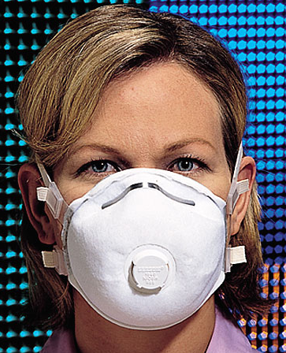
How Filtering Facepieces Work
Air inhaled in
Air inhaled in
Air exhaled out
Notes:
[optional slide] This picture shows how air moves in and out of the dust mask respirator with an exhalation valve. The act of breathing creates a negative pressure inside the mask, which is why these and dust masks are sometimes called “negative pressure respirators”. If the mask does not fit properly along the edges, contaminated air can enter. This is why fit-testing is essential when using dust mask respirators. More about fit-testing in following slides.

Slide 5
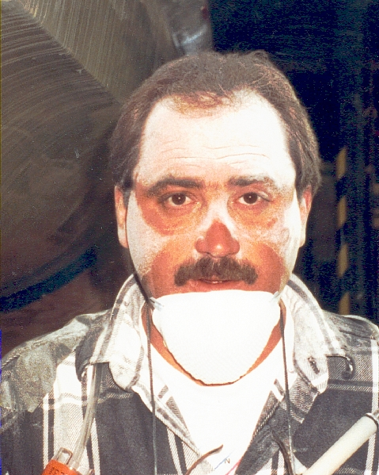

Using Filtering Facepieces
Limits of Dust Masks
Dust masks will leak if they don’t fit your face properly.
Dust masks don’t filter out chemical vapors.
Dust masks are not adequate for heavy amounts of dust.
Dust masks may not be suitable for highly toxic dusts.
Notes:
The first picture shows some leakage around the nose (dust under the nose) which means the dust mask didn’t fit properly. Dust masks work well for wood dust, low levels of sandblasting dust, lime dust, grain dust, fiberglass dust, plastics dust. They can provide protection up to 10 times the permissible exposure limit of the particular dust. They won’t provide enough protection against higher levels (above 10 times the “safe limit”) of silica sand sandblasting dust, dry cutting of concrete or brick or dry drilling in rock, or certain toxic metal dusts such as lead, cadmium and arsenic.

Slide 6
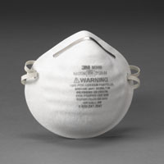
Dust Mask Protection Factor
How much protection does a dust mask give?
Dust masks only provide protection to levels 10 times above the chemical or dust permissible exposure limit (PEL).
Example
Wood dust permissible limit – 5 mg/cu. meter
Dust mask protects up to 50 mg/cu. meter
mg/cu. meter = milligrams per cubic meter
Notes:
“ Another way of saying this is that it is assumed that a dust mask reduces the amount of chemical inside the respirator to one tenth of the concentration outside the respirator, providing it fits properly and has no holes or tears. If the level of chemical in the air is more than 10 times the permissible limit, you would need a more protective respirator. Permissible limits for about 600 chemicals and dusts are published by WISHA. The limits for some very toxic dusts are much lower than wood dust.”
5 mg/cu. meter of wood dust will be a noticeable dust cloud. 50 mg/cu. meter of wood would be very dense cloud and would probably only occur in a small room with no ventilation where heavy sanding or cutting was done. However, some dusts (such as silica sand dust from sandblasting) have much lower allowable limits and dust levels from sandblasting can easily exceed the protection factor of a dust mask. Most sandblasting activity requires a supplied air respirator.

Slide 7
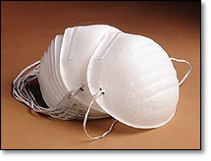
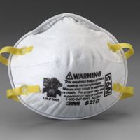
NIOSH–Approved Dust Masks
Dust masks come in variety of styles and brands.
Not all dust masks provide adequate protection for workplace dust.
Only NIOSH-approved dust masks can be used for protection against dust levels that exceed the PEL.
Not NIOSH-approved
NIOSH-approved
Notes:
NIOSH is the National Institute of Occupational Safety & Health. All respirators used in the workplace for protection against chemicals and dust must be NIOSH-approved. Single-strapped dusts masks are not NIOSH-approved. So-called “comfort masks” or “allergy masks” are also not NIOSH approved. The NIOSH approval will be found printed directly on the mask or on the mask package or carton.

Slide 8
Types of Dust Masks
Some masks are more protective than others
N95/R95/P95 masks filter out 95% of dust particles
N99/R95/P99 masks filter out 99% of dust particles
N100/R100/P100 masks filter out 99.7% of dust particles
N99 or N100 masks are recommended for very fine dust or dangerous dusts such as asbestos or silica.
Notes:
[This slide is optional if you use more than one type of dust masks] The “N” means not resistant to oil mist, “R” means somewhat resistant to oil mist, and the “P” means the mask is strongly resistant to oil mist. Most work situations do not have oil mist in the air and the “N” masks suffice.

Slide 9
Where Dust Masks Can’t Be Used
Dust masks will not provide adequate protection in the following situations:
Exposure to chemical gases or vapors
Dust levels more than 10 times the
permissible exposure limit (PEL)
Oxygen deficiency
Notes:
“Dust masks do not filter out gases or vapors at all, and of course do not provide oxygen. For these reason dust masks are not recommended for any confined space work. Some dust masks have a layer of charcoal to capture so-called “nuisance” odors or vapors, but these cannot be used if the chemical levels in the air exceed the PEL.”

Slide 10
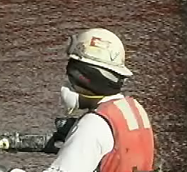

Dust Mask Fit
Dust Masks Must Fit Properly
Dust masks must fit properly to prevent leaks around the edges.
Fit-testing must be done before first wearing a dust mask.
Beards do not allow a good fit when wearing a dust mask.
Notes:
[The top photo shows a worker with a poorly fitting dust mask – only one strap is used and it appears to be upside down. He was drilling in concrete and was often enveloped in a cloud of dust. Concrete dust contains silica, a substance that scars the lungs.]
Fit-testing is extremely important because without a tight fit, a respirator is nearly useless. You may think you are protected when in fact you are not, if the respirator does not fit properly. Beards are not allowed because they will always cause a respirator to leak around the edges. Even a day’s growth of facial hair can cause a leak. Mustaches are usually O.K., but goatees usually cause the respirator to leak unless they are small.”

Slide 11
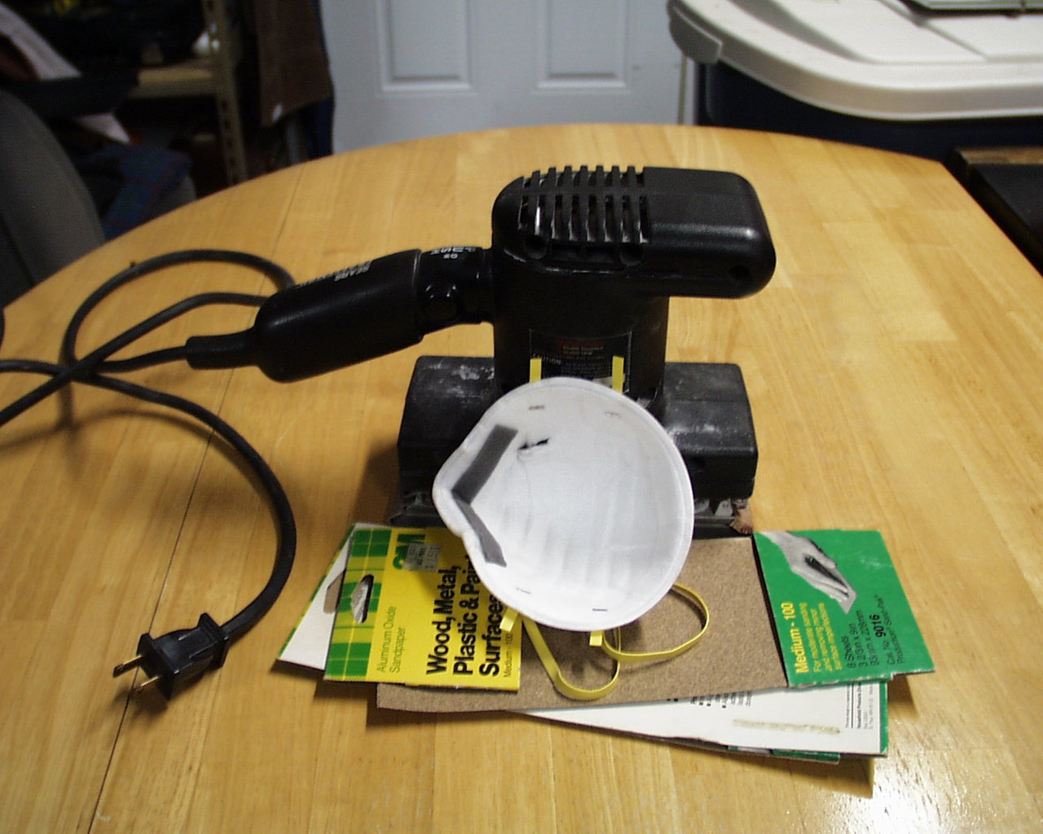
Replacing Dust Masks
Replace dust masks at least daily
Dust masks cannot be cleaned or repaired if soiled or damaged.
Replace dust masks if breathing becomes difficult, if they are damaged or soiled on the inside.
Dispose of dust masks at the end of the day or shift.
Torn mask
Notes:
Note the tear in the mask in the red circle. This mask must be replaced. Dust masks must also be worn with both straps attached to the head, Otherwise they will probably leak.

Slide 12
Dust Mask Problems
When it Smells Bad or You Feel Sick
If you notice an odor, find dust inside the mask, feel ill, or you think your respirator leaks, notify your supervisor.
Leave the area if you know your mask is leaking.
Notes:
“Your respirator may leak because of a poor fit or a tear or hole in the mask. Sometimes you may feel ill without noticing an odor since some chemicals and most dusts have no noticeable odor. Be especially aware of such symptoms as dizziness, nausea, coughing, nose or throat irritation, feeling “high”, or having trouble breathing.”

Slide 13
Quiz
Question 1
What do filtering facepieces protect you from?
  solvents and dust
  only dust and particles
  nothing much
  only pollen
Notes:
The correct answer is b).

Slide 14
Quiz
Question 2
Why can’t you wear a dust mask over a beard?
a) The beard will interfere with your breathing
b) It will cause the respirator to leak
c) It will cause skin irritation
d) It will look stupid
Notes:
The correct answer is b).

Slide 15
Quiz
Question 3
What does it mean if you smell a chemical while wearing your dust mask?
a) You may need a different kind of respirator
b) The dust mask doesn’t fit properly
c) You have a very sensitive nose
Notes:
a) is the best answer since dust masks do not filter chemical vapors with an odor. c) may be true, but the point is that dust masks don’t provide protection from chemical gases or vapors.

