Slide 1

COMBUSTABLE
DUST
AWARENESS
CONCIENCIA POLVO COMBUSTIBLE

Slide 2
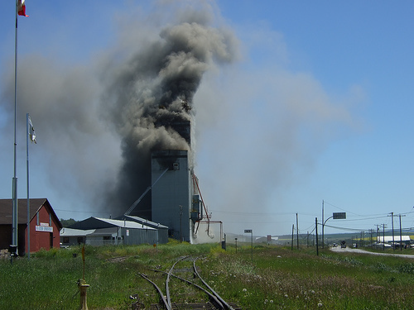
WHAT IS A DUST EXPLOSION?
Lo que es una explosion de polvo?
A dust explosion occurs when a fine, combustible dust is suspended in air and ignited. This causes a very rapid burning with a release of gaseous products and subsequent pressure rise. The resulting explosive force can damage plant, property, and people. Dust explosions can be categorized as either primary or secondary.
Spanish

Slide 3
PRIMARY EXPLOSION
Explosion primaria
A primary explosion takes place in a confined atmosphere such as a storage silo, or enclosed part of the plant. After detonation, the shock wave can damage and often rupture walls, allowing burning dust and gases from the explosion to be expelled into the surrounding area.
Spanish

Slide 4
SECONDARY EXPLOSION
Explosion secundaria
The primary explosion will disturb settled dust that may have accumulated. Once airborne, this dust can support a larger explosion; this is referred to as a secondary explosion. Secondary explosions can cause severe damage to surrounding plant buildings as a result from chain reactions by the initial explosion.
Spanish

Slide 5
CASCADING EXPLOSIONS
Explosiones en cascada
Primary Explosion / Explosion primaria
Secondary Explosion /
Explosion secundaria
Blast Wave
Onda de choque
Dust Accumulation
Acumulacion de polvo
Heat from Primary Explosion ignites second dust cloud
El calor de la explosion primaria enciende segundo polvo
Dust cloud forms
Se forma una nube de polvo

Slide 6
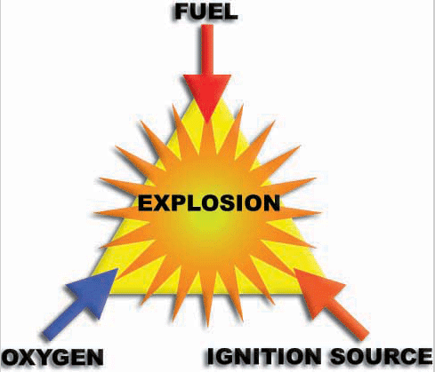
ELEMENTS OF A DUST EXPLOSION
Elementos de una explosion de polvo
combustible
oxigeno
Fuente de ignicion

Slide 7
WHERE DOES DUST FORM?
Donde se forma el polvo?
Horizontal surfaces (pipes, beams, equipment)
Floor
Air – from cleaning
Servicios horizontales (tuberia, haz, equipo)
Piso
Aire – de limpieza

Slide 8

IS ONLY DUST IN AIR EXPLOSIVE?
Es solo polvo en el aire explosiva?
NO!
NO!

Slide 9
IGNITION SOURCES
Fuentes de ignicion
Some common ignition sources in the plant could include/ Alguna fuente de ignicion es comun en el edificio podria incluir:
Fire
Spark (metal, electrical switch)
Static discharge / spark (dust moving in air, clothing)
Heat source
Fuego
Chispa (metal, interruptor electrico)
Descarga estatic / chispa (polvo de
desplazamiento en el aire, ropa)
Fuente de calor

Slide 10
EXPLOSION SAFEGUARDS
Salvaguardias explosion
Safeguards need to be activated to control the chances of a dust explosion / Garantias necesarieas para ser activado para controlar el riesgo de una explosion:
Awareness
Housekeeping – keeping the environment clean
Eliminating fugitive dust (dust leaking from other sources)
Eliminating as many hazards as possible.
Conciencia
Limpieza – mantener el area limpia
La eliminacion de polvo de otras fuentes
Como la eliminacion de muchos peligros como sea posible

Slide 11
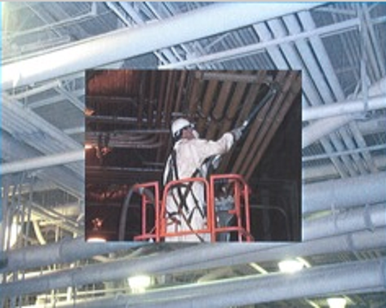
DUST CONTROL METHODS
Metodos de control de polvo
Vacuum areas where dust accumulation occurs
Wash down procedures where hoses and water can be used to remove accumulated dust.
Choke feeds to control the flow of grain and grain dust.
Avoid using air systems
Dust control systems such as filters or cyclones.
Zonas de vacio donde se produce la acumulacion de polvo
Procedimientos de limpieza eran las mangueras y el agua se puede utilizar para eliminar el polvo acumulado
Evitar el uso de sistemas de aire
Sistemas de control de polvo como los
filtros o ciclones

Slide 12
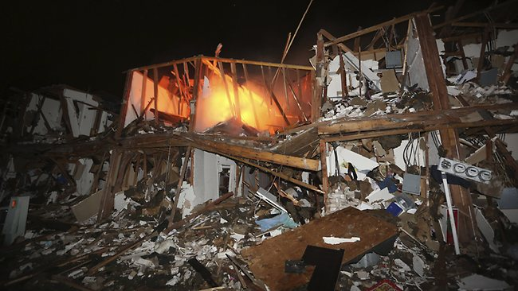
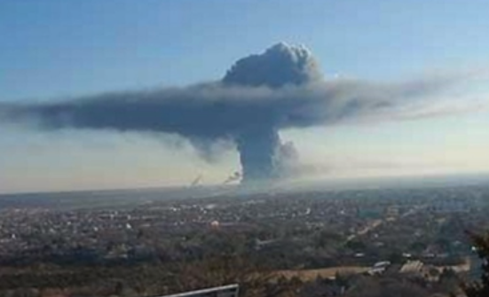
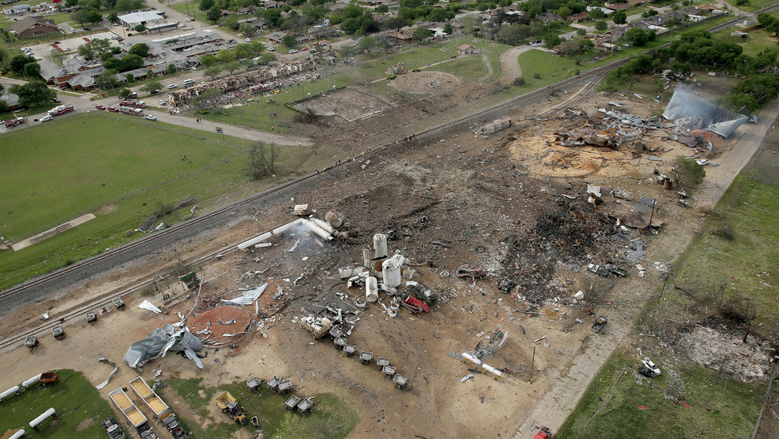
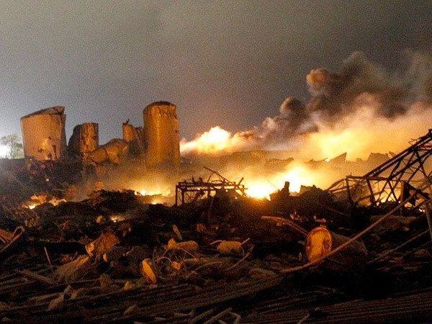
04.17.13 West, Tx Fertilizer Plant – 14 DEAD.

